Slide 1
Report : Lidar Assisted Controller
Date: 14/10/25
Supervisor: prof. David Schlipf
Group members: Midhun Kanichattu Venu,Hesham Mahmoud

Slide 2
List of contents
Bladed control interface (pre-v4.4)
Swap array communication
Handshaking and synchronization
Data exchange flow
Midhun Kanichattu Venu 770588

Slide 3
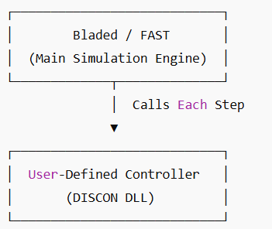
Bladed Control Interfaces
Who calls whom
Bladed is the main simulation engine
Calls the User-Defined Controller (DLL or EXE) each timestep
Controller reads inputs → computes → returns outputs
How Signal Transfer Works
DLL Case: uses array avrSWAP in memory (faster, direct)
EXE Case: uses shared binary file discon.swp
Each record = one signal (4 bytes)
Record 1 used for handshaking (0 = wait, 1 = ready, -1 = end)
Midhun Kanichattu Venu 770588

Slide 4
Handshake Process (Record 1)
Bladed Simulation
Flow:
Controller writes 0 → ready
Bladed sets 1 → data ready
Controller reads, writes outputs, sets 0 again
Simulation continues
Csharp
AvrSwap Array
User Controller Dll
Output
Bladed
Midhun Kanichattu Venu 770588

Slide 5
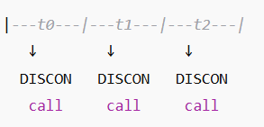
Array Data Exchange
Record | Direction | Description | Units
2 | In | Current time | s
4 | In | Blade 1 pitch angle | rad
20 | In | Generator speed | rad/s
45 | Out | Commanded pitch | rad
47 | Out | Commanded torque | Nm
Execution Timing
Midhun Kanichattu Venu 770588
Midhun Kanichattu Venu 770588

Slide 6
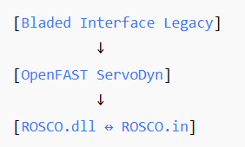
Link to OpenFAST
OpenFAST’s ServoDyn → ROSCO.dll uses same interface
avrSWAP = same memory layout
DISCON.IN = replaced by ROSCO.IN
Signals (speed, pitch, torque) are identica
Midhun Kanichattu Venu 770588

Slide 7
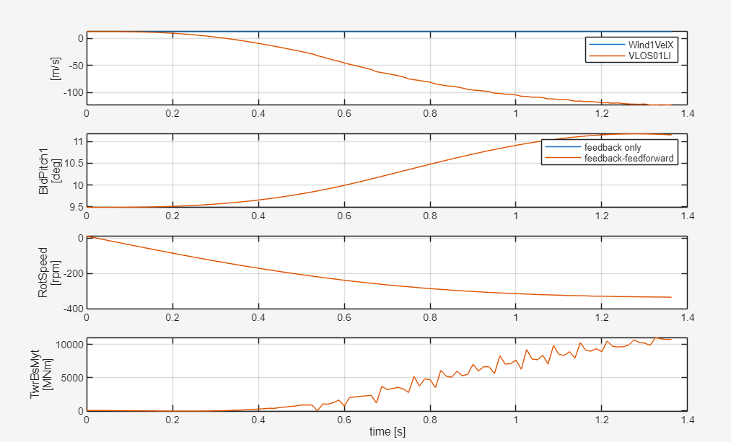
Result
Midhun Kanichattu Venu 770588

Slide 8
summary
Bladed calls controller each timestep
Signals exchanged via avrSWAP (float array)
Handshake ensures sync
ROSCO in OpenFAST uses same interface
Midhun Kanichattu Venu 770588

Slide 9
Bibliography – Lidar Assisted controller
Hansen, M. Aerodynamics of Wind Turbines, 3rd Ed., Routledge, 2015.
Ingram, G. Wind Turbine Blade Element Momentum Theory, 2011.
Bossanyi, E. Controller Design for Variable-Speed Wind Turbines, Wind Engineering, 2000
Midhun Kanichattu Venu 770588

